Slide 1






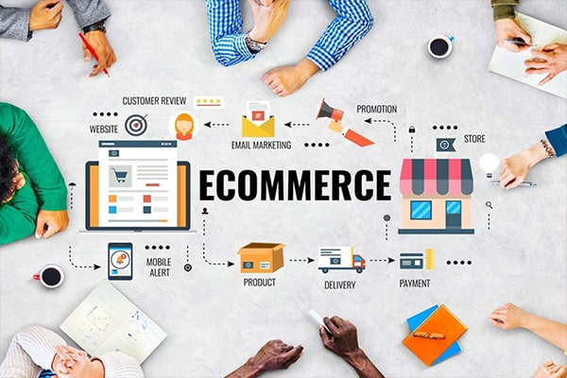

Olist Store Empowering E-Commerce
Mentor: Prepared By:
Ms. Deepti 1) Satyendra Patle
2) Rupali Bhangare
3) Shradha Majumdar
4) K. Sai Sowjanya
5) Gaurav Mandlik

Slide 2
Olist Store - Overview
Olist Store Empowering E-Commerce
Olist Store is the largest department store in Brazilian marketplaces.
Olist connects small businesses from all over Brazil to channels without hassle and with a single contract.
Olist Store public dataset of orders (from 2016 to 2018) is provided for analysis.
The dataset has information of 100k orders made at multiple marketplaces in Brazil. Its features allow viewing an order from multiple dimensions: from order status, price, payment and freight performance to customer location, product attributes and finally reviews written by customers.

Slide 3
Objective
Olist Store Empowering E-Commerce
Critically analysis of the provided datasets using Business Intelligence tools and provide marketing findings / recommendations in a report format.
This project intends to explore various aspects of e-commerce business like customer behavior, sales trends, product popularity, seller performance and supply chain
The objective is to provide a guide for developing marketing strategies, inventory management, sellers operations and logistics activities.

Slide 4
Data Set
Olist Store Empowering E-Commerce
olist_customers_dataset
olist_geolocation_dataset
olist_order_items_dataset
olist_order_payments_dataset
olist_order_reviews_dataset
olist_orders_dataset
olist_products_dataset
olist_sellers_dataset
product_category_name_translation

Slide 5
Project Process
Olist Store Empowering E-Commerce
Extract Data
Transformation
Load Data
KPIs & Visualization Charts
Dashboard
Manage Data Sets Relationship

Slide 6

Joins
Olist Store Empowering E-Commerce

Slide 7




Tools used
Olist Store Empowering E-Commerce

Slide 8
Overall Analytics
Olist Store Empowering E-Commerce
Total Orders
98673
Orders executed from 2016 to 2018
Total Products
32789
Vast range of Product SKUs
Total Customers
98673
Customers using services
Total Sellers
3090
Total Payments
15.70M
Revenue generated from 2016 to 2018
Sellers associated

Slide 9

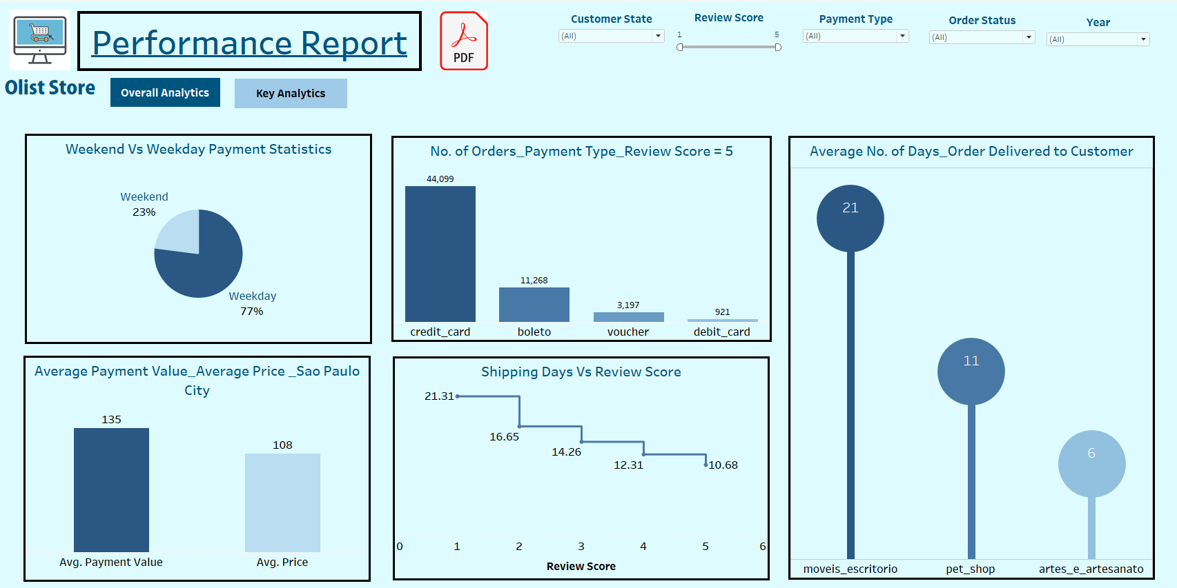
Key Analytics – KPI 1
Olist Store Empowering E-Commerce
Weekday revenue/payment is 77% approx. 11.60M whereas on weekends its 23% which is 3.47M
Its evident that customers are shopping more on weekdays compared to weekend.
Sufficient inventory to be maintained on weekdays
Marketing Team should work out on special offers/ sale days on weekends to boost weekend sales

Slide 10
Key Analytics – KPI 2
Olist Store Empowering E-Commerce
Credit card is most preferred mode of payment . 74% of highly satisfied customer (Review score 5) use credit cards
Ensure the user interface is customer friendly and secure for making credit card payments which will result in fastest and secure check out process
Sales through vouchers can be boosted with some marketing strategies. Eg. Employees getting shopping vouchers as rewards which they can encash on the ecommerce platform.

Slide 11
Key Analytics – KPI 3
Olist Store Empowering E-Commerce
The average number of days taken for pet_shop is 11 days
This provides insight on the speed at which the order is processed right from punching the order to delivering to the customer.
Evaluate with the seller if the number of days can be reduced further resulting in enhancement of customer experience

Slide 12
Key Analytics – KPI 4
Olist Store Empowering E-Commerce
The average price is $108 and the average payment value is $135
On study it is observed that both price & payment values are higher for Sao Paulo city compared to the other cities
Despite of high values the customers of Sao Paulo have placed maximum orders i.e. 15428 indicating they are high income groups and have high purchasing capacity
Olist should ensure high quality premium products without Any defects are supplied in order to justify high price and to ensure customer satisfaction
Marketing team should work on some price reduction which may further boost the sales and take on competitor share as well

Slide 13
Key Analytics – KPI 5
Olist Store Empowering E-Commerce
There is negative correlation between number of shipping days and the review score given by customers
Longer the shipping days results in customer dissatisfaction which is evident in the customer review score
Olist should review the operational efficiencies to reduce the shipping days Eg. Olist can give guidelines with regard to shipment dispatch, maintaining inventory for fast moving products, onboard fastest delivery partners etc.

Slide 14
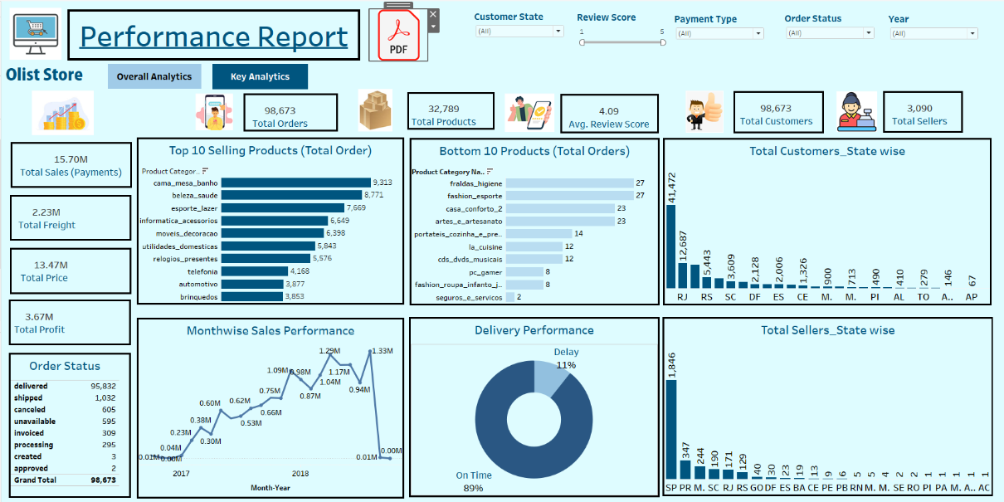
Some Important Highlights
Olist Store Empowering E-Commerce
Order Status indicates positive insight that the loss due to order cancellation or unavailability of products is minimal.
This shows the products listed are of high quality and caters to customers requirements
Also the sellers are ensuring sufficient stocks are available

Slide 15
Some Important Highlights
Olist Store Empowering E-Commerce
This showcases the 89% of orders delivery is done within the estimated time of deliveries which is a positive attribute
The company can further reduce the delays by reviewing the root cause of delays and take necessary actions

Slide 16
Some Important Highlights
Olist Store Empowering E-Commerce
It is evident that the month on month sales have incresead from 2016 till 2018
Highest recorded is in Nov’18 of 1.33M
Some peaks are observed at various internals, marketing team should review impact of seasonal/festival impact. Accordingly strategies can be designed to boost sales. Eg. Nov is the black Friday time

Slide 17
Some Important Highlights
Olist Store Empowering E-Commerce
Product wise performance of orders gives insights on the major contributors to the business
Top 10 selling products – ensure sufficient inventory availability, study cost benefit analysis to ensure they contribute to maximum profit, marketing strategy to boost sales
Bottom 10 selling products – need to review if the products should be kept in the basket which will reduce the inventory carrying cost.

Slide 18
Some Important Highlights
Olist Store Empowering E-Commerce
Large disparity is observed in the state wise customer mix. Almost 60% of customers are from state code SP.
Olist to ensure sufficient sellers are available in SP state. Also the logistics is strong to achieve delivery in minimum time
At same time, review is required for other states having low customer count.

Slide 19
Dashboard
Olist Store Empowering E-Commerce

Slide 20
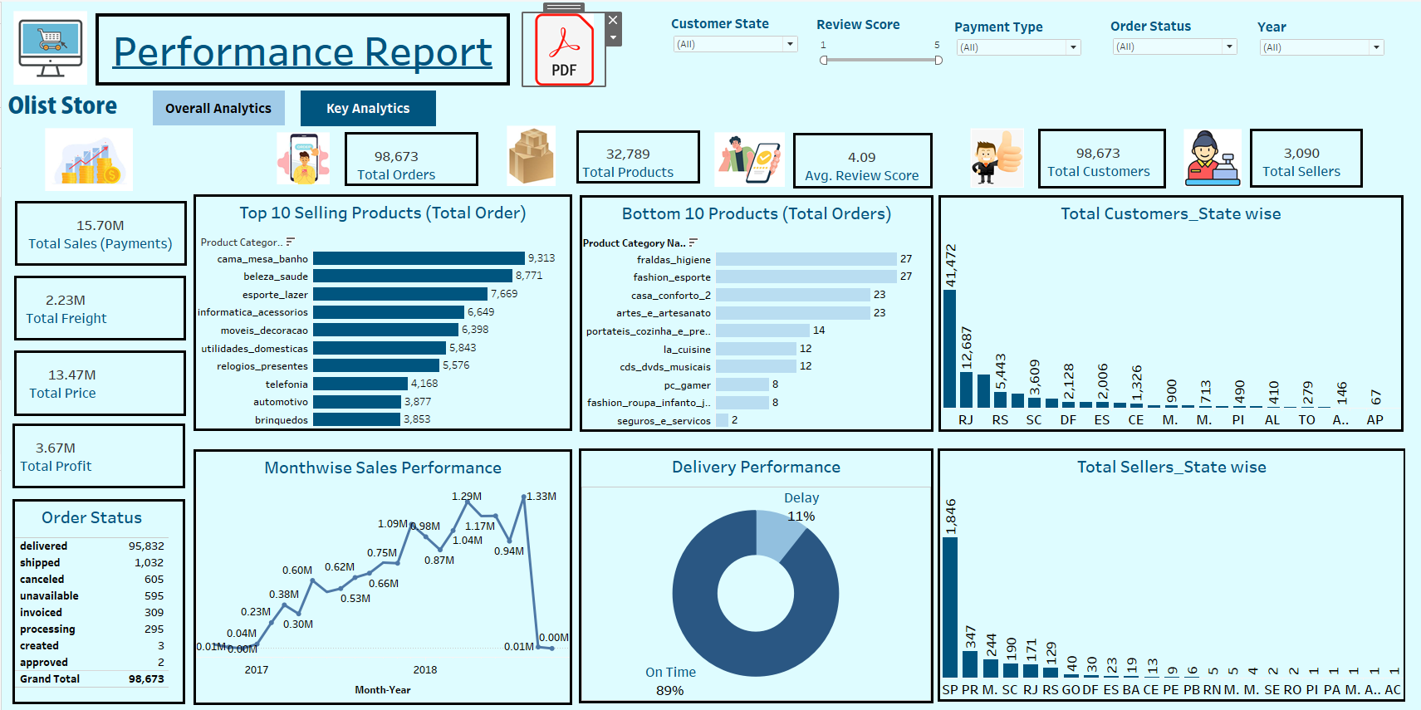

Slide 22
Summary
Olist Store Empowering E-Commerce
The project on Olist Store was conducted using tools Excel & MySQL data modelling, manipulation and visualization. Interactive dashboards were created using Power BI & Tableau
The KPIs focus on total orders, average payment value, average price, shipping days, review score, mode of payment, weekday/weekend performance
Overall to summarize the Olist Store is performing and its business is growing year on year. Regular monitoring of customer reviews, strong marketing strategy, real time tracking of shipping performance will help Olist to improve supply chain, boost sales and help to achieve customer satisfaction.

Slide 23
Thank You
Olist Store Empowering E-Commerce

